Slide 1

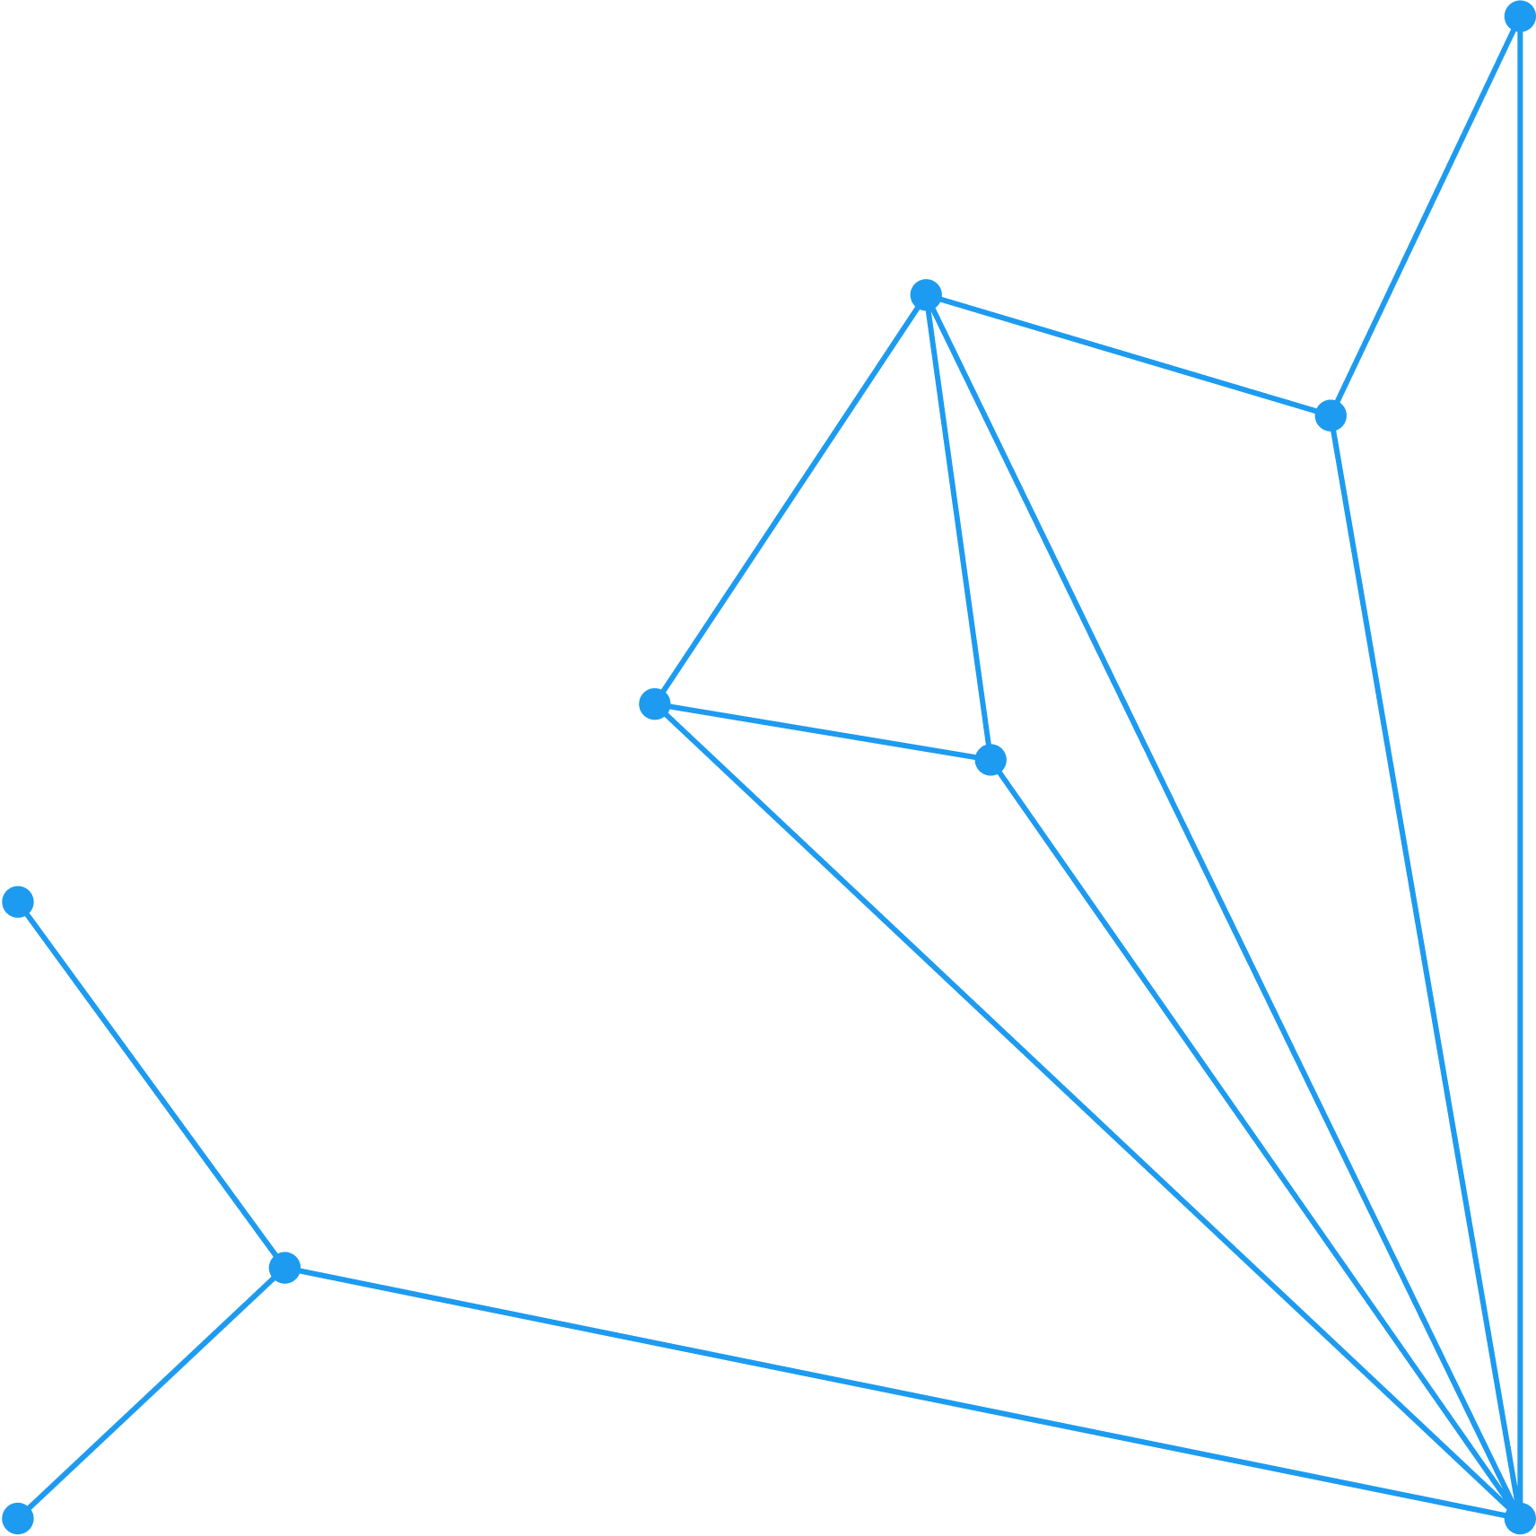





Overview of Economic EValuation
Session Recap
BY Tabitha Okech
Research Fellow- Health Technology Assessment
Center for Epidemiological Modelling and Analysis
1

Slide 2
Session Outline
Concept of economic evaluations (What and Why?)
Overview of different types of analysis (cost-effectiveness analysis, cost-utility analysis, budget impact analysis, and cost-benefit analysis)
Overview of different types of decision models
Synthesis of evidence from decision models
Budget Impact Analysis
3

Slide 3
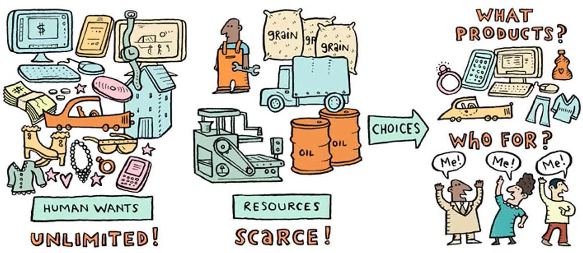
Human wants are unlimited, but resources are scarce
Medications
Consultations Vaccines
3

Slide 4



E c o n o m I c E v a l u a t I o n s
Intervention A
Intervention B
Outcome
Outcome
Cost
Cost
✔ Comparison of the costs and outcomes of alternative policy options.
✔ Additional unit of resources spent per additional unit of outcome gained

Slide 5

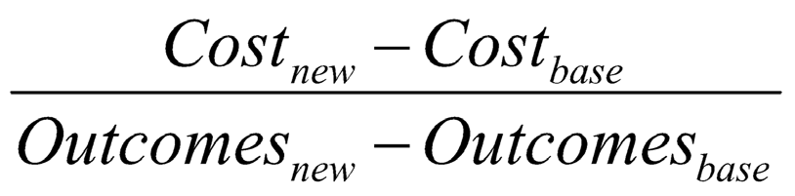
Economic
evaluations
Base/Comparator
Current practice
No interventions or technologies
Intervention of interest
New health interventions or
technologies
3

Slide 6
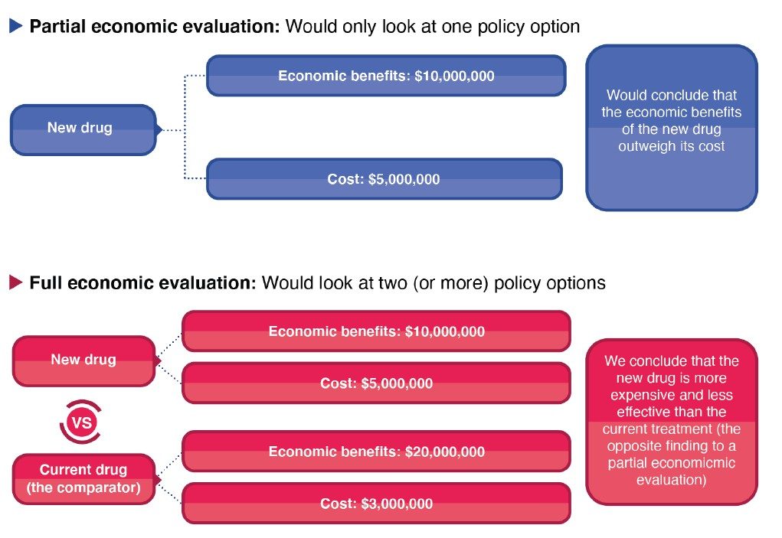
Economic
evaluations
3

Slide 7















Type of costs (by traceability)
Direct costs
Indirect costs
Intangible costs
Medical costs
Non-Medical costs
Productivity loss*
Monetary value¹ of pain, suffering, distress e.g., willingness-to-pay for pain avoidance.
*Productivity gains or losses related to illness or death
¹It is very difficult to measure and are often omitted from cost analyses.

Slide 8

Type of costs - ‘cost to whom?’
Perspectives
Societal perspective
The perspective must be specified because it determines which costs
Provider perspective
to consider and whose values to use
Patient perspective
Payer perspective
Sittimart M, Rattanavipapong W, Mirelman AJ, Hung TM, Dabak S, Downey LE, Jit M, Teerawattananon Y, Turner HC. An overview of the perspectives used in health economic evaluations. Cost Eff Resour Alloc. 2024 May 14;22(1):41. doi: 10.1186/s12962-024-00552-1. PMID: 38741138; PMCID: PMC11092188.

Slide 9








Type of outcomes
Economic (monetary value)
Clinical e.g., reduce risk, length of stay, cure rate, mortality
Humanistic e.g., health-related quality of life

Slide 10

Economic Evaluations
Cost
Outcome
CMA
CBA
CEA
CUA

Slide 11

Different types of economic evaluations
Type | Costs (nominator) | Consequences (denominator) | Result
Cost-minimisation |  | - | Cost per case (Choose the cheapest option)
Cost-effectiveness |  | Process or health outcome in natural unit e.g., case detected (screening) or case averted (prevention) & death averted (treatment) | ICER (cost per life-year gained, cost per case detected)
Cost-utility |  | Outcome in a common unit e.g., QALY, DALY | ICER (cost per QALY, cost per DALY)
Cost-benefit |  |  | Net benefit Benefit-to-cost ratio Return on investment (ROI)
ICER = Incremental cost-effectiveness ratio; QALY = Quality adjusted life year; DALY = Disability averted life year
Turner HC, Archer RA, Downey LE, Isaranuwatchai W, Chalkidou K, Jit M, Teerawattananon Y. An Introduction to the Main Types of Economic Evaluations Used for Informing Priority Setting and Resource Allocation in Healthcare: Key Features, Uses, and Limitations. Front Public Health. 2021 Aug 25;9:722927. doi: 10.3389/fpubh.2021.722927. PMID: 34513790; PMCID: PMC8424074.

Slide 12
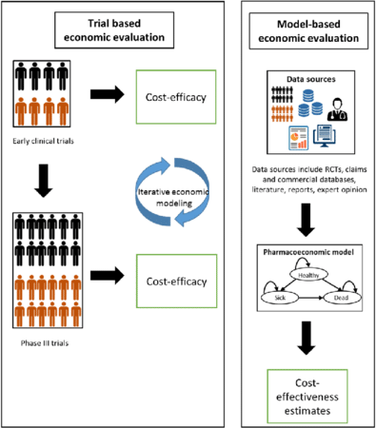
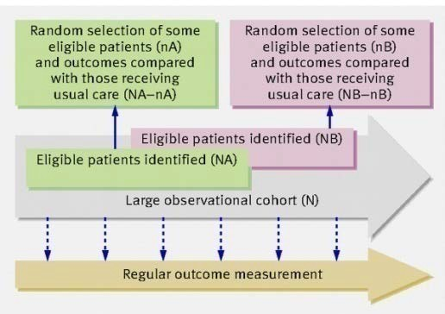
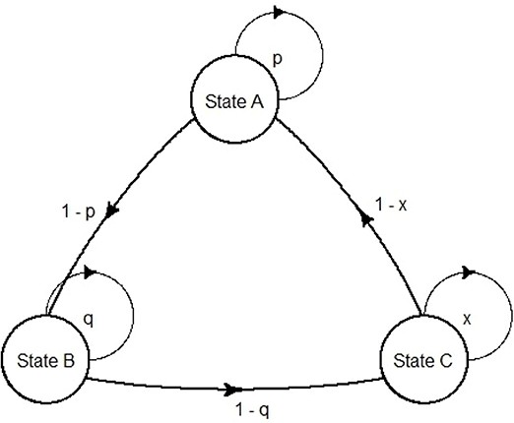
Different methods for economic evaluation
Alongside clinical trial | Pragmatic Trial | Modeling
Srinivasan M et al. Pharmacoeconomics. 2020; 38(10): 1031–1042. | Relton C et al. BMJ 2010;340:bmj.c1066 | Andrea C, Claudio C, Front. Public Health 2020;8:569500
Efficacy: as a part of clinical trial Cost: From trial | Effectiveness: pragmatic trial Cost: From trial | Efficacy or effectiveness and cost: systematic review and meta-analysis, survey or databases
Limitations: Number of comparators Intermediate outcome Gold standard measurement of outcomes | Limitations: Number of comparators • +/- intermediate outcome | Limitations: Garbage in -- Garbage out Data availability

Slide 13
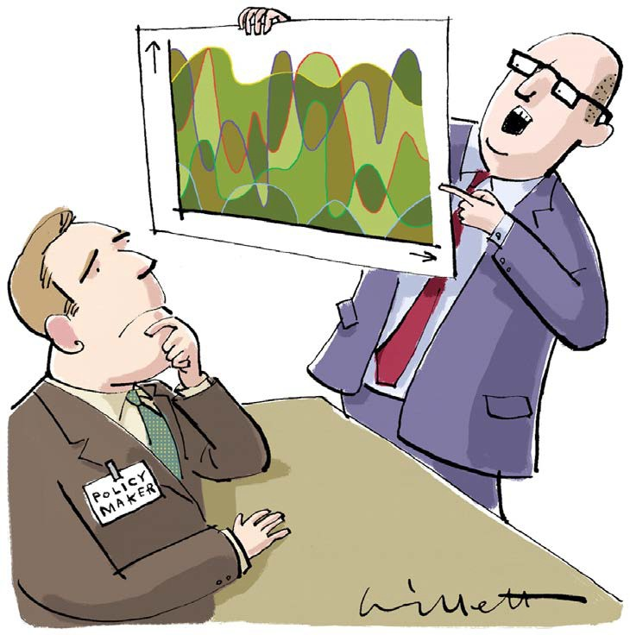
Why do we need to conduct a decision model?
“If we know future events with certainty, decision making process is easy and we don’t need decision analysis.”
But…do we actually know what the future holds?

Slide 14

Decision models I n h e a l t h c a r e
Input parameters
Outputs
Transitional probabilities
Model
Mathematical simulation of a real- world situation to project possible consequences from adopting health interventions/technologies
Tailored to the purpose for which it is to be used
Synthesise data from various sources
Useful tool for informing decisions makers
Easy to communicate
Uncertainty in data inputs
Cost-effectiveness analysis
Costs
Budget impact analysis
Outcomes
Other relevant variables
Uncertainty analysis
Predicts the future
Explore the uncertainty

Slide 15









Decision models use with caution
Garbage data
Garbage result
Garbage Model
Good data
Garbage result
Garbage Model
Garbage data
Garbage result
Good Model
Good data
Useful result
Good Model

Slide 16


Data for the models
Data Collection
Time
Retrospective Study
Prospective Study
Cheaper and less time required
Useful in cases of rare diseases
✗ All required data may not be available
Can design data collection as required
✗ More resource intensive
Some examples
Some examples
e-claim system
Hospital databases
Surveys
Interviews
Clinical follow-up
Either of them may not guarantee the quality of the data, and validation steps may be conducted after.

Slide 17


Value Adjustment
A key consideration of time preference
Would you rather….?
Cost
have 1,000 USD by today
have 1,000 USD next week
have 1,000 USD by today
have 1,200 USD next month
Outcome
be physically and mentally healthy now
be physically and mentally healthy next year

Slide 18




Cost Adjustment
Varies across countries (e.g., 3%, 5%)
Inflation (CPI)
Discount Rate
Past
Present
Future
𝑃𝑃𝑃𝑃 = 𝐶𝐶𝐶𝐶𝐶𝐶𝐶𝐶 ×
^{𝐶𝐶𝑃𝑃𝐶𝐶}𝑝𝑝𝑝𝑝𝑝𝑝𝑝𝑝𝑝𝑝𝑝𝑝𝑝𝑝
^{𝐶𝐶𝑃𝑃𝐶𝐶}𝑝𝑝𝑝𝑝𝑝𝑝𝑝𝑝
Accounting for the opportunity cost associated with spending money now rather than in the future and the societal time preference
Accounting for how the purchasing power of a currency has changed over time.
PV = Present value; CPI = Consumer Price Index

Slide 19
Time horizon
Cumulative cost
10
Determines the duration over which the outcomes and costs are calculated.
8
6
Cumulative
benefit
Modelling approaches may be needed to estimate outcomes that are beyond available data.
4
2
0
0
2
4
6
8
10
Time
Guidelines typically recommend using a time horizon long enough to capture all relevant costs and health benefits.
The higher the discount rate, the less important future outcomes and costs are.
Slide courtesy of Dr Hugo C turner

Slide 20
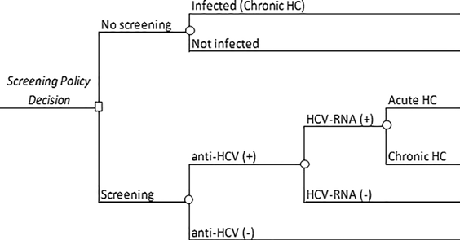
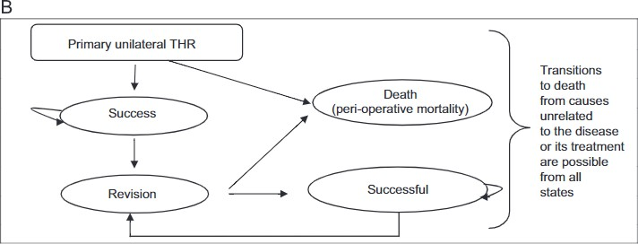
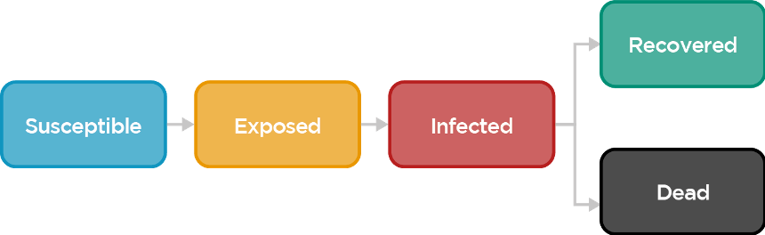
Different types of decision models
Decision trees
Markov models
Dynamics models (infectious diseases)
Essentially, repeated decision trees (over longer time periods)
Similar to Markov models, but patients can interact (e.g., by infecting each other)
Short term situations with several possible outcomes (above is essentially one hospital visit)
Complexity (generally)

Slide 21
How to choose your decision model?
Model Type | General Description | Type of Decision Best suit for
Decision Tree Model | Diagrams the risk of events and states of nature over a fixed time horizon | Interventions for which the relevant time horizon is short and fixed, recommended for acute intervention with no recurrent
Markov Model | Stimulate a hypothetical cohort of individuals through a set of health states over time | Modeling interventions for diseases or conditions that involves risk over a long-time horizon and/or recurrent events
Dynamic Model | A model that allows forms of interaction between individuals | Recommended when the interaction between individuals needs to be taken into accounts, for example infectious diseases
Cooper, K., Brailsford, S. C., & Davies, R. (2007). Choice of modelling technique for evaluating health care interventions. Journal of the Operational Research Society, 58(2), 168–176. https://doi.org/10.1057/palgrave.jors.2602230 Barton P, Bryan S, Robinson S. Modelling in the economic evaluation of health care: selecting the appropriate approach. Journal of Health Services Research & Policy. 2004;9(2):110-118. doi:10.1258/135581904322987535

Slide 22
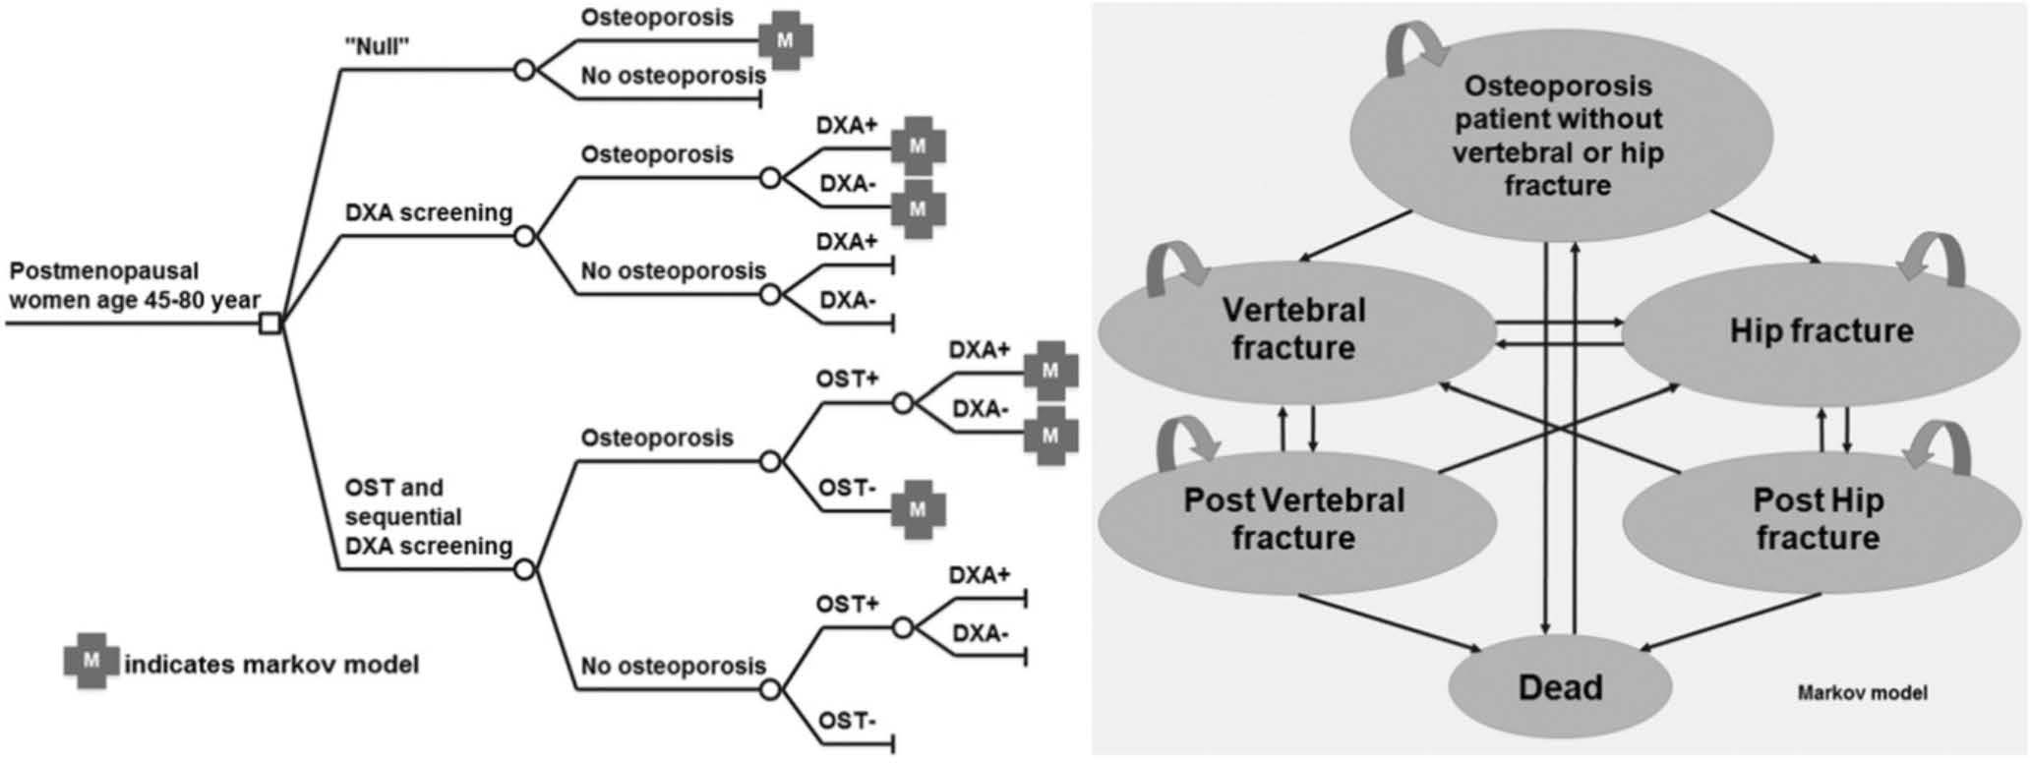
Combining between Decision tree and Markov Model
Kingkaew P, Maleewong U, Ngarmukos C, Teerawattananon Y. Evidence to inform decision makers in Thailand: a cost-effectiveness analysis of screening and treatment strategies for postmenopausal osteoporosis. Value Health. 2012 Jan-Feb;15(1 Suppl):S20-8. doi: 10.1016/j.jval.2011.11.015. PMID: 22265062.

Slide 23
Overview steps for building a decision
model
Specifying the decision problem
Examples of key considerations
What is the disease of interest?
What are the health technologies or interventions of interest, and what should we compare them with?
Defining the boundaries of the model
What is the objective of our analysis?
Which type of decision model we should use?
What outcomes from the health technologies we are interested in?
What is the targeted population?
Which perspective we should perform the analysis?
What should be the time horizon?
Structuring a decision model
Synthesising evidence
Stakeholder consultation(s)
Analysis result presentation, ICER values, Cost-effectiveness (CE) plane, uncertainty communication
Dealing with uncertainty
Additional analyses: sensitivity analysis, subgroup analysis, scenario analysis, etc.
Model utilisation
Uses in different time points of health technology life cycle (pre-market, market approval, post market), pricing, understanding of value for money, price negotiation, accessibility etc.

Slide 24
Overview steps for building a decision
model
Specifying the decision problem
Examples of key considerations
What is the disease of interest?
What are the health technologies or interventions of interest, and what should we compare them with?
Defining the boundaries of the model
What is the objective of our analysis?
Which type of decision model we should use?
What outcomes from the health technologies we are interested in?
What is the targeted population?
Which perspective we should perform the analysis?
What should be the time horizon?
Structuring a decision model
Synthesising evidence
Analysis result presentation, ICER values, Cost-effectiveness (CE) plane, uncertainty communication
Dealing with uncertainty
Additional analyses: sensitivity analysis, subgroup analysis, scenario analysis, etc.
Model utilisation
Uses in different time points of health technology life cycle (pre-market, market approval, post market), pricing, understanding of value for money, price negotiation, accessibility etc.
We will later cover these topics in other lectures

Slide 25
Overview steps for building a decision
model
Specifying the decision problem
Examples of key considerations
What is the disease of interest?
What are the health technologies or interventions of interest, and what should we compare them with?
Defining the boundaries of the model
What is the objective of our analysis?
Which type of decision model we should use?
What outcomes from the health technologies we are interested in?
What is the targeted population?
Which perspective we should perform the analysis?
What should be the time horizon?
Structuring a decision model
Synthesising evidence
Analysis result presentation, ICER values, Cost-effectiveness (CE) plane, uncertainty communication
Dealing with uncertainty
Additional analyses: sensitivity analysis, subgroup analysis, scenario analysis, etc.
Model utilisation
Uses in different time points of health technology life cycle (pre-market, market approval, post market), pricing, understanding of value for money, price negotiation, accessibility etc.

Slide 26




Evidence synthesis
Decision Problem
A
Standard
Treatment
Incremental Comparison
B
New
Treatment
Health Outcomes:
Clinical success
Life year
QALY
etc.
Cost A (C_{A}) Health Outcome A (E_{A})
Cost (C_{B}) Health Outcome (E_{B})
C_{B} – C_{A}
Δ𝐶𝐶
Comparison of ICER against Threshold
Incremental Cost- Effectiveness Ratio
< 𝜆𝜆
ICER =
=
E – E
Δ𝐸𝐸
B
A

Slide 27
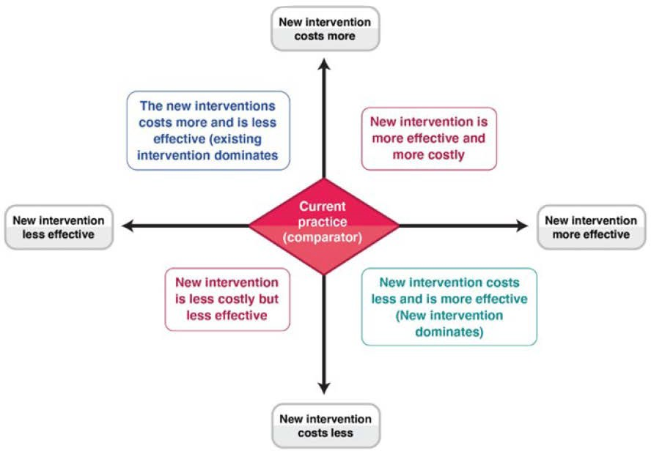
Evidence synthesis
Cost-effectiveness plane

Slide 28
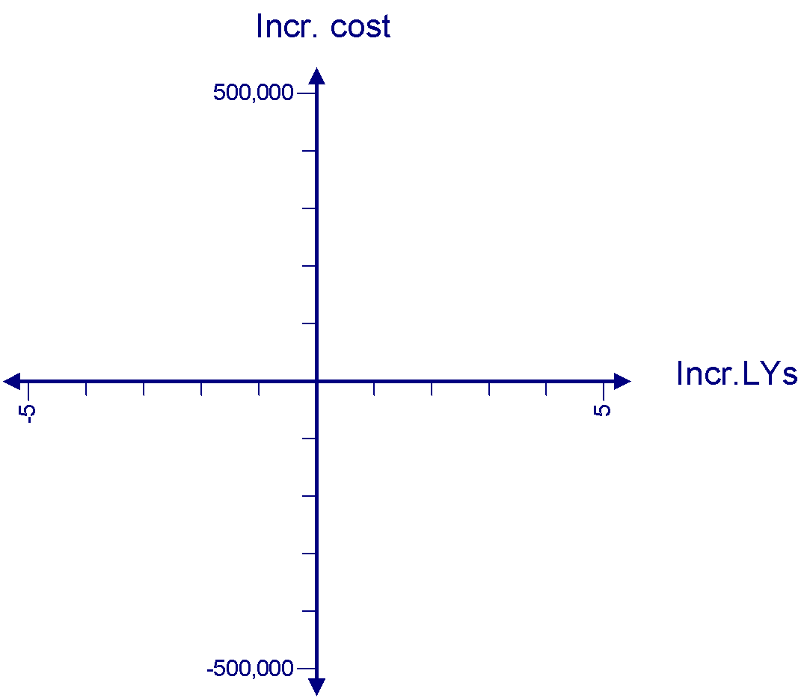



Evidence synthesis
Cost-effectiveness plane
Incremental cost
X ICER 180,000
2
✔ Decision rules: accept technology, if ICER < Willingness-to-pay threshold
1
ICER 60,000
X ICER -200,000
5
3
ICER 25,000
C
Current treatment
Incremental QALY
4
ICER -200,000

Slide 29
How do we make the decision?
Cost-effectiveness Analysis (CEA)
Budget Impact Analysis (BIA)
Is it good “value for money”?
Useful for resource allocation decisions among different
interventions
Is it affordable?
Useful for budget planning and forecasting, and estimating budget holder's affordability

Slide 30
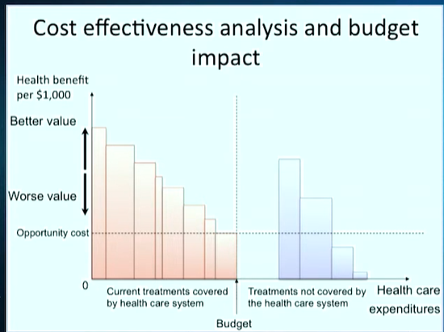
What trade-offs do we have to make between cost-effectiveness and budget impact?

Slide 31
How to conduct Budget Impact Analysis

Slide 32
Key elements in BIA
Analytic model structure
  Framework (alongside CEA disease model and stand-alone BIAs)
  Perspective
  Timeframe
  Target population
  Scenarios to compare (technology and comparator)
  Cost
  Modeling/Calculation
Input and data sources
Handling uncertainty
Reporting format

Slide 33
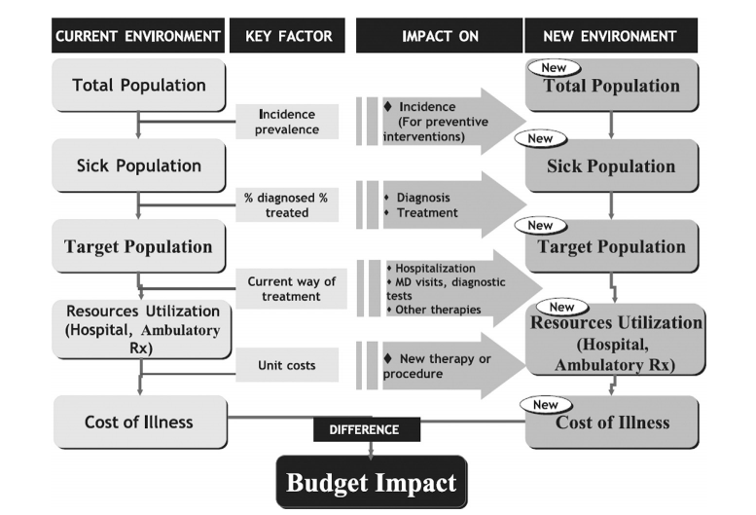
ISPOR Framework

Slide 34
Analytic model structure
  Perspective
    BIA usually takes the perspective of the budget holder.
    The impact of the new intervention on productivity, social services, and other costs outside the health care system (e.g. indirect costs) should not be included routinely in a BIA, since these aspects are not generally relevant to the budget holder.
  Timeframe
    Short time frame (1-5 years)
    BIA should incorporate a time horizon that is relevant to the budget holder e.g. reflecting their budgetary timelines (quarterly? Annually?)
    Discounting is not recommended for a BIA because discounted costs do not reflect the actual budget in given year.

Slide 35
Time dependency and Budgetary silos
Time dependency
BIA will be affected by many factors over time
  New market entrants
  End of patient protection
  Exchange rate variation
All these need to be captured in the BIA model
Budgetary silos
CEAs draw on many budgets
  Hospital, pharmacy, laboratory, community health
  Investments in one budget can drive savings elsewhere
Consider providing silo specific BIAs while balancing the transferability of budget savings

Slide 36
Handling Uncertainty
  Parameter uncertainty
    Utilization trends
    Health outcome
    Effectiveness and adverse effects
    Utilization of comparative intervention
    Utilization of unrelated health/social care
  Scenario Analysis
  Just like CEA, BIA comes with a considerable level of uncertainty. The BIA should reflect the plausible array of circumstances the budget holder may face.
    E.g. Coverage/drug uptake,
    E.g. Proportion of patients
    E.g. Risk sharing agreements with the manufacturers
    Sensitivity Analysis
    data obtained from data sources by the extension of the range or the confidence interval of the input variables

Slide 37
Health system characteristics
Is there a single health care funder? Eg NHIF funds in-patient treatment but not out-patient treatment
  How does this affect uptake for this treatment?
Do all patients have equal coverage/access?
  How does this affect treatment mix?
  Does this have implications for indirect budget impact effects?

Slide 38

Take-home message
Decision models represent simplifications of reality
They can be used to perform EE, comparing costs and outcomes of at least two policy options
Types of EE and decision models to use should depend on context of decision problems
Results derived from EE allow us to understand the value of money of health technologies/interventions in relation to their comparator

Slide 39

Coming up next!
Cost
…
Economic evaluation modelling
Uncertainty analysis
Budget impact analysis (BIA)
…
outcome

